Slide 1
Requirements Engineering

Slide 2
Words of Wisdom
As adults, our choices are unlimited. Even in the worst of circumstances, we could make several choices. Remember to be free is to be free to choose. Make a wise choice.
Say “ Ye shall not be questioned as to our sins nor shall we be questioned as to what ye do” Al-Qur’an (34:25)

Slide 3
In the last lecture we covered
Software Development Process Models
From Requirements Engineering perspective
Generic Requirements Engineering activities
Requirements Engineering Process Models
RE Process Maturity and Improvement

Slide 4
Requirements Elicitation
‘Elicitation’ is not universally accepted
Identifying
Gathering
Determining
Formulating
Extracting
Exposing
The term “elicitation” is preferred to “capture”, to avoid the suggestion that requirements are out there to be collected simply by asking the right questions. (Goguen & Jirotka 1994)
Elicitation refers to gathering the requirements of the system from different stakeholders. Boundaries, identification of stakeholders, goals and tasks performed are discovered in this phase (Nuseibeh and Easterbrook, 2000).

Slide 5
Why do elicitation?
Not doing elicitation means “I do not want to know [or care] what my customer wants?”
Resulting in to a system which will not solve real world problem of the customer.
The system will not be used and thus fail.
Return on investment?

Slide 6
How to do requirements elicitation?
Elicitation is the process of
identifying needs and bridging the disparities among the involved communities for the purpose of defining and distilling requirements to meet the constraints of these communities
Requirements elicitation itself can be broken down into the activities
fact-finding
Information gathering, and
Integration

Slide 7
Requirements Elicitation Process
Rzepka decomposes the elicitation process
Identify the relevant parties which are sources of requirements.
The party might be an end user, an interfacing system, or environmental factors.
Gather the “wish list” for each relevant party.
This wish list is likely to originally contain ambiguities, inconsistencies, infeasible requirements, and un-testable requirements, as well as probably being incomplete.
Document and refine the “wish list” for each relevant party.
The wish list includes all important activities and data, and during this stage it is repeatedly analyzed until it is self-consistent. The list is typically high level, specific to the relevant problem domain, and stated in user-specific terms.
Integrate the wish lists across the various relevant parties (viewpoints)
thereby resolving the conflicts between the viewpoints. Consistency checking is an important part of this process. The wish lists, or goals, are also checked for feasibility.
Determine the nonfunctional requirements, such as performance and reliability issues, and state these in the requirements document.

Slide 8
Requirements Elicitation Process
Fact Finding
Reqs gathering &
classification
Evaluation &
Rationalization
Prioritization
Integration & Validation

Slide 9
Components of requirements elicitation

Slide 10
Elicitation activities
Application domain understanding
Application domain knowledge is knowledge of the general area where the system is applied.
Problem understanding
The details of the specific customer problem where the system will be applied must be understood.
Business understanding
You must understand how systems interact and contribute to overall business goals.
Understanding the needs and constraints of system stakeholders
You must understand, in detail, the specific needs of people who require system support in their work.

Slide 11
The requirements elicitation process

Slide 12
Elicitation stages
Objective setting
The organizational objectives should be established including general goals of the business, an outline description of the problem to be solved, why the system is necessary and the constraints on the system.
Background knowledge acquisition
Background information about the system includes information about the organization where the system is to be installed, the application domain of the system and information about existing systems
Knowledge organization
The large amount of knowledge which has been collected in the previous stage must be organized and collated.
Stakeholder requirements collection
System stakeholders are consulted to discover their requirements.

Slide 13
Focus of Elicitation
Collect “enough” information to:
identify problem Boundaries
Which problem needs to be solved?
understand the Context/Problem Domain
Where is the problem?
identify Stakeholders
Whose problem is it?
identify the stakeholders’ Goals
Why does it need solving?
collect some Scenarios
How might a software system help?
identify Development Constraints
When does it need solving?
identify Feasibility and Risk
What might prevent us solving it?

Slide 14
Outcomes of Requirement Elicitation
Tangible
Intangible
Users or buyers
A full understanding of requirements and separation of ‘want’ and ‘need’
A good understanding of the decisions they have made in developing the requirements
A sense of ownership
Feel informed and educated
Committed to the success of the project
Software Engineer or Developer
Solving the right problem
Confidence that Solution is feasible
They have trust and confidence of the customers
Customer co-operation
Knowledge of the domain of the system

Slide 15
Elicitation Techniques

Slide 16
Requirements Elicitation Techniques
Traditional techniques
Reading existing documents
Analyzing hard data
Interviews
Surveys / Questionnaires
Meetings
Collaborative techniques
Focus Groups
Storyboarding
Prototyping
Model-based techniques
Goal-based
Scenario-Based
Use Cases
Contextual (social) approaches
Ethnographic techniques
Discourse Analysis
Socio-technical Methods
Cognitive techniques
Task analysis
Knowledge Acquisition Techniques

Slide 17
Existing Documents
Background Reading
company reports, organization charts, policy manuals, job descriptions, reports, documentation of existing systems, etc.
understanding of the organization before meeting the people
being aware of the business objectives of the organization
Existing Solution Systems
Documentation
User manuals
requirements specification document
May be seen as reengineering method for documents transferring user documentation into basic elements of information for requirements
Focus is on Commonality and Variability

Slide 18
Hard Data Collection
Identify Collections of Hard Data
Facts and figures, financial information,…
Reports used for decision making,…
Survey results, marketing data,…
Sampling
Sampling used to select representative set from a population
Sample Size is important
balance between cost of data collection/analysis and required significance
Process:
Decide what data should be collected - e.g. banking transactions
Determine the population to be sampled - e.g. all transactions at 5 local branches over one week
Choose type of sample - e.g. simple random sampling
Choose sample size - e.g. every 10th transaction

Slide 19
Interviewing
Simple direct technique
Context-free questions can help achieve bias-free interviews
Then, it may be appropriate to search for undiscovered requirements by exploring solutions.
Convergence on some common needs will initiate a “requirements repository” for use during the project.
A questionnaire is no substitute for an interview.
Notes:
Examples of context-free questions?

Slide 20
Interview: Context free question
Goal is to prevent prejudicing the user’s response to the questions.
Examples:
Who is the user?
Who is the customer?
Are their needs different?
Where else can a solution to this problem be found?
Context-free questions also parallel the questions salespeople are taught to ask as part of a technique called “solutions selling.”
After context-free questions are asked, suggested solutions can be explored.

Slide 21
Interview: Show time
Establish Customer or User Profile
Assessing the Problem
Understanding the User Environment
Recap the Understanding
Analyst’s Inputs on Customer’s Problems
Assessing Your Solution (if applicable)
Notes:
Establish Customer or User Profile
Name:
Company:
Industry:
Job Title:
What are your key responsibilities?
What outputs do you produce?
For Whom?
How is success measured?
Which problems interfere with your success?
What, if any, trends make your job easier or more difficult?
Assessing the Problem
For which problems do you lack good solutions?
What are they? (Hint: Keep asking, “Anything else?”)
For each problem ask:
Why does the problem exist?
How do you solve it know?
How would you like to solve it?
Understanding the User Environment
Who are the users?
What is their educational background?
What is their computer background?
Are users experienced with this type of application?
Which platforms are in use?
What are your plans for future platforms?
What are your expectations for usability for this type of product?
What are your expectations for training time?
What kinds of user help do you need?
Recap the Understanding
You have told me:
(List customer described problems in your own words.)
Analyst’s Inputs on Customer’s Problems
(Validate or Invalidate assumptions)
For each problem ask,
Is this a real problem?
What are the reasons for the problem?
How do you currently solve the problem?
How would you like to solve the problem?
How would you rank solving these problems in comparison to others you’ve mentioned?
Assessing Your Solution (if applicable)
What if you could
How would you rank the importance of these?

Slide 22
Collaborative Elicitation Techniques
Types:
Focus Groups
Brain Storming
JAD
Requirements Workshop
Prototype
CSCW

Slide 23
Focus Group
Form groups of people using some focus (e.g., management levels)
Advantages
More natural interaction between people than formal interview
Can gauge reaction to stimulus materials (e.g. mock-ups, storyboards, etc)
Disadvantages
May create unnatural groups (uncomfortable for participants)
Danger of Groupthink
May only provide superficial responses to technical questions
Requires a highly trained facilitator
Watch for
sample bias
dominance and submission

Slide 24
Requirements Workshop
The requirements workshop is perhaps the most powerful technique for eliciting requirements.
It gathers all key stakeholders together for a short but intensely focused period.
The use of an outside facilitator experienced in requirements management can ensure the success of the workshop.
Brainstorming is the most important part of the workshop.

Slide 25
Preparing for the workshop
Selling the workshop concept to stakeholders
Ensuring the Participation of the Right Stakeholders
Logistics
Try and prevent Murphy’s law
Includes travel, lighting, and even afternoon sugar filled snacks.
Warm-up materials
Project-specific information
Out-of-box thinking preparation

Slide 26
Role of the Facilitator
Establish professional and objective tone to the meeting.
Start and stop the meeting on time.
Establish and enforce the “rules” for the meeting.
Introduce the goals and agenda for the meeting.
Manage the meeting and keep the team “on track.”
Facilitate a process of decision and consensus making, but avoid participating in the content.
Make certain that all stakeholders participate and have their input heard.
Control disruptive or unproductive behavior.

Slide 27
Workshop Agenda
Set an agenda before the workshop and publish it along with the other pre-workshop documentation.
Balance is the key, try to stay on the agenda, but do not strictly obey it, especially if good discussion is going on.
Order lunch in, and have a light working lunch. :-)

Slide 28
Running the Workshop
Allow for human behavior, and have fun with it.
Do not “attack” other members.
Do not get on a soap box.
Do not come back late from a break.
Workshop tickets
Give every stakeholder 3 workshop tickets
1 for being late
1 for “cheap shot”
1 for “soap box”
Facilitator takes tickets when appropriate. If you do not have a ticket create a fund to add to, like $1 to pot for after workshop activities.

Slide 29
Workshop Problems and Solutions
Time Management
It’s difficult to get going after breaks and lunch.
Key shareholders may be late returning
Grandstanding, domineering positions
Lack of input from stakeholders
Negative comments, petty behaviors, and turf wars
Flagging energy after lunch
Facilitator keeps a timer for all breaks and fines anyone that is late, everyone gets one free pass.
Everyone gets one 5 minute position statement.
Facilitator encourages everyone to use 5-minute position and great idea ticket.
Use “Cheap Shot Tickets”, all others go into the fine pot.
Lite lunches, afternoon breaks, rearrange seating
Notes:
What does this have to do with engineering? Everything. So far, the only creatures we have found to use as engineers are people. Same goes for marketing, testing, strategic planning, etc.
The engineer’s tendency to shy away from actions needed to encourage, cajole, and motivate humans to be productive leads to unproductive meetings.

Slide 30
Storyboard
A Storyboard is a logical and conceptual description of system functionality for a specific scenario, including the interaction required between the system users and the system.
A Storyboard is a sequence of images which demonstrate the relationship between individual screens and actions within a system
A Storyboard "tells a specific story".

Slide 31
Storyboarding
Scripted walkthrough of system activities and/or screen mockups
Storyboards identify the players, explain what happens to them, and describes how it happens.
Typically expressed in the form of activity diagrams
to show workflow or performed actions
may be partitioned to show control flow between different classes
Usually tied to use cases
activity partitions correspond to actors

Slide 32
Types of Storyboards
Passive storyboards
Tell a story to the user.
Consist of sketches, pictures, screen shots, PowerPoint presentations, or sample application outputs.
Walks the user through the storyboard, with a "When you do this, this happens" explanation.
Active storyboards
Try to make the user see "a movie that hasn't actually been produced yet.“
Provide an automated description of the way the system behaves in a typical usage or operational scenario.
Interactive storyboards
Let the user experience the system in as realistic a manner as practical.
Require participation by the user.

Slide 33
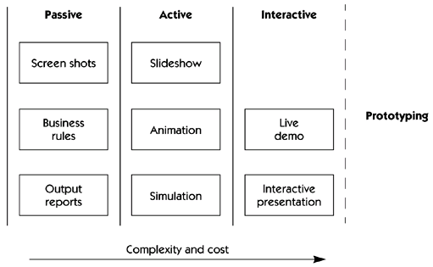
Storyboarding Continuum

Slide 34
What Storyboards Do
In software, storyboards are used most often to work through the details of the human-to-machine interface.
In this area, generally one of high volatility, each user is likely to have a different opinion of how the interface should work.
Storyboards for user-based systems deal with the three essential elements of any activity:
Who the players are
What happens to them
How it happens

Slide 35
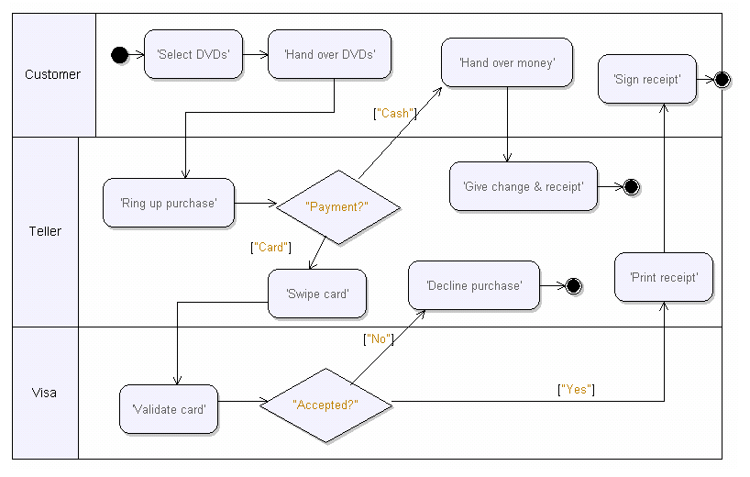
A Sample Storyboard

Slide 36
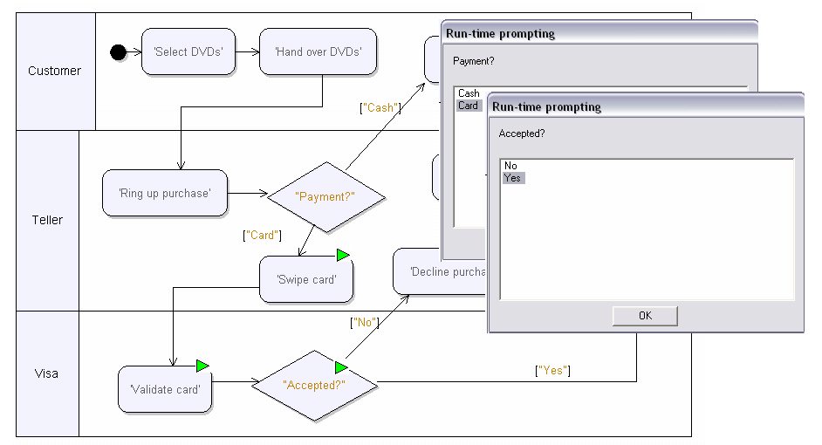
Animating a Storyboard

Slide 37
Q&A

